Slide 1
ELON UNIVERSITY KICKBOX
“Golf Ball Pendulum”

Slide 2
Fun!
Science!
Art!

Slide 3
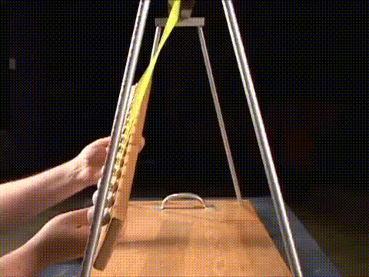

Slide 4
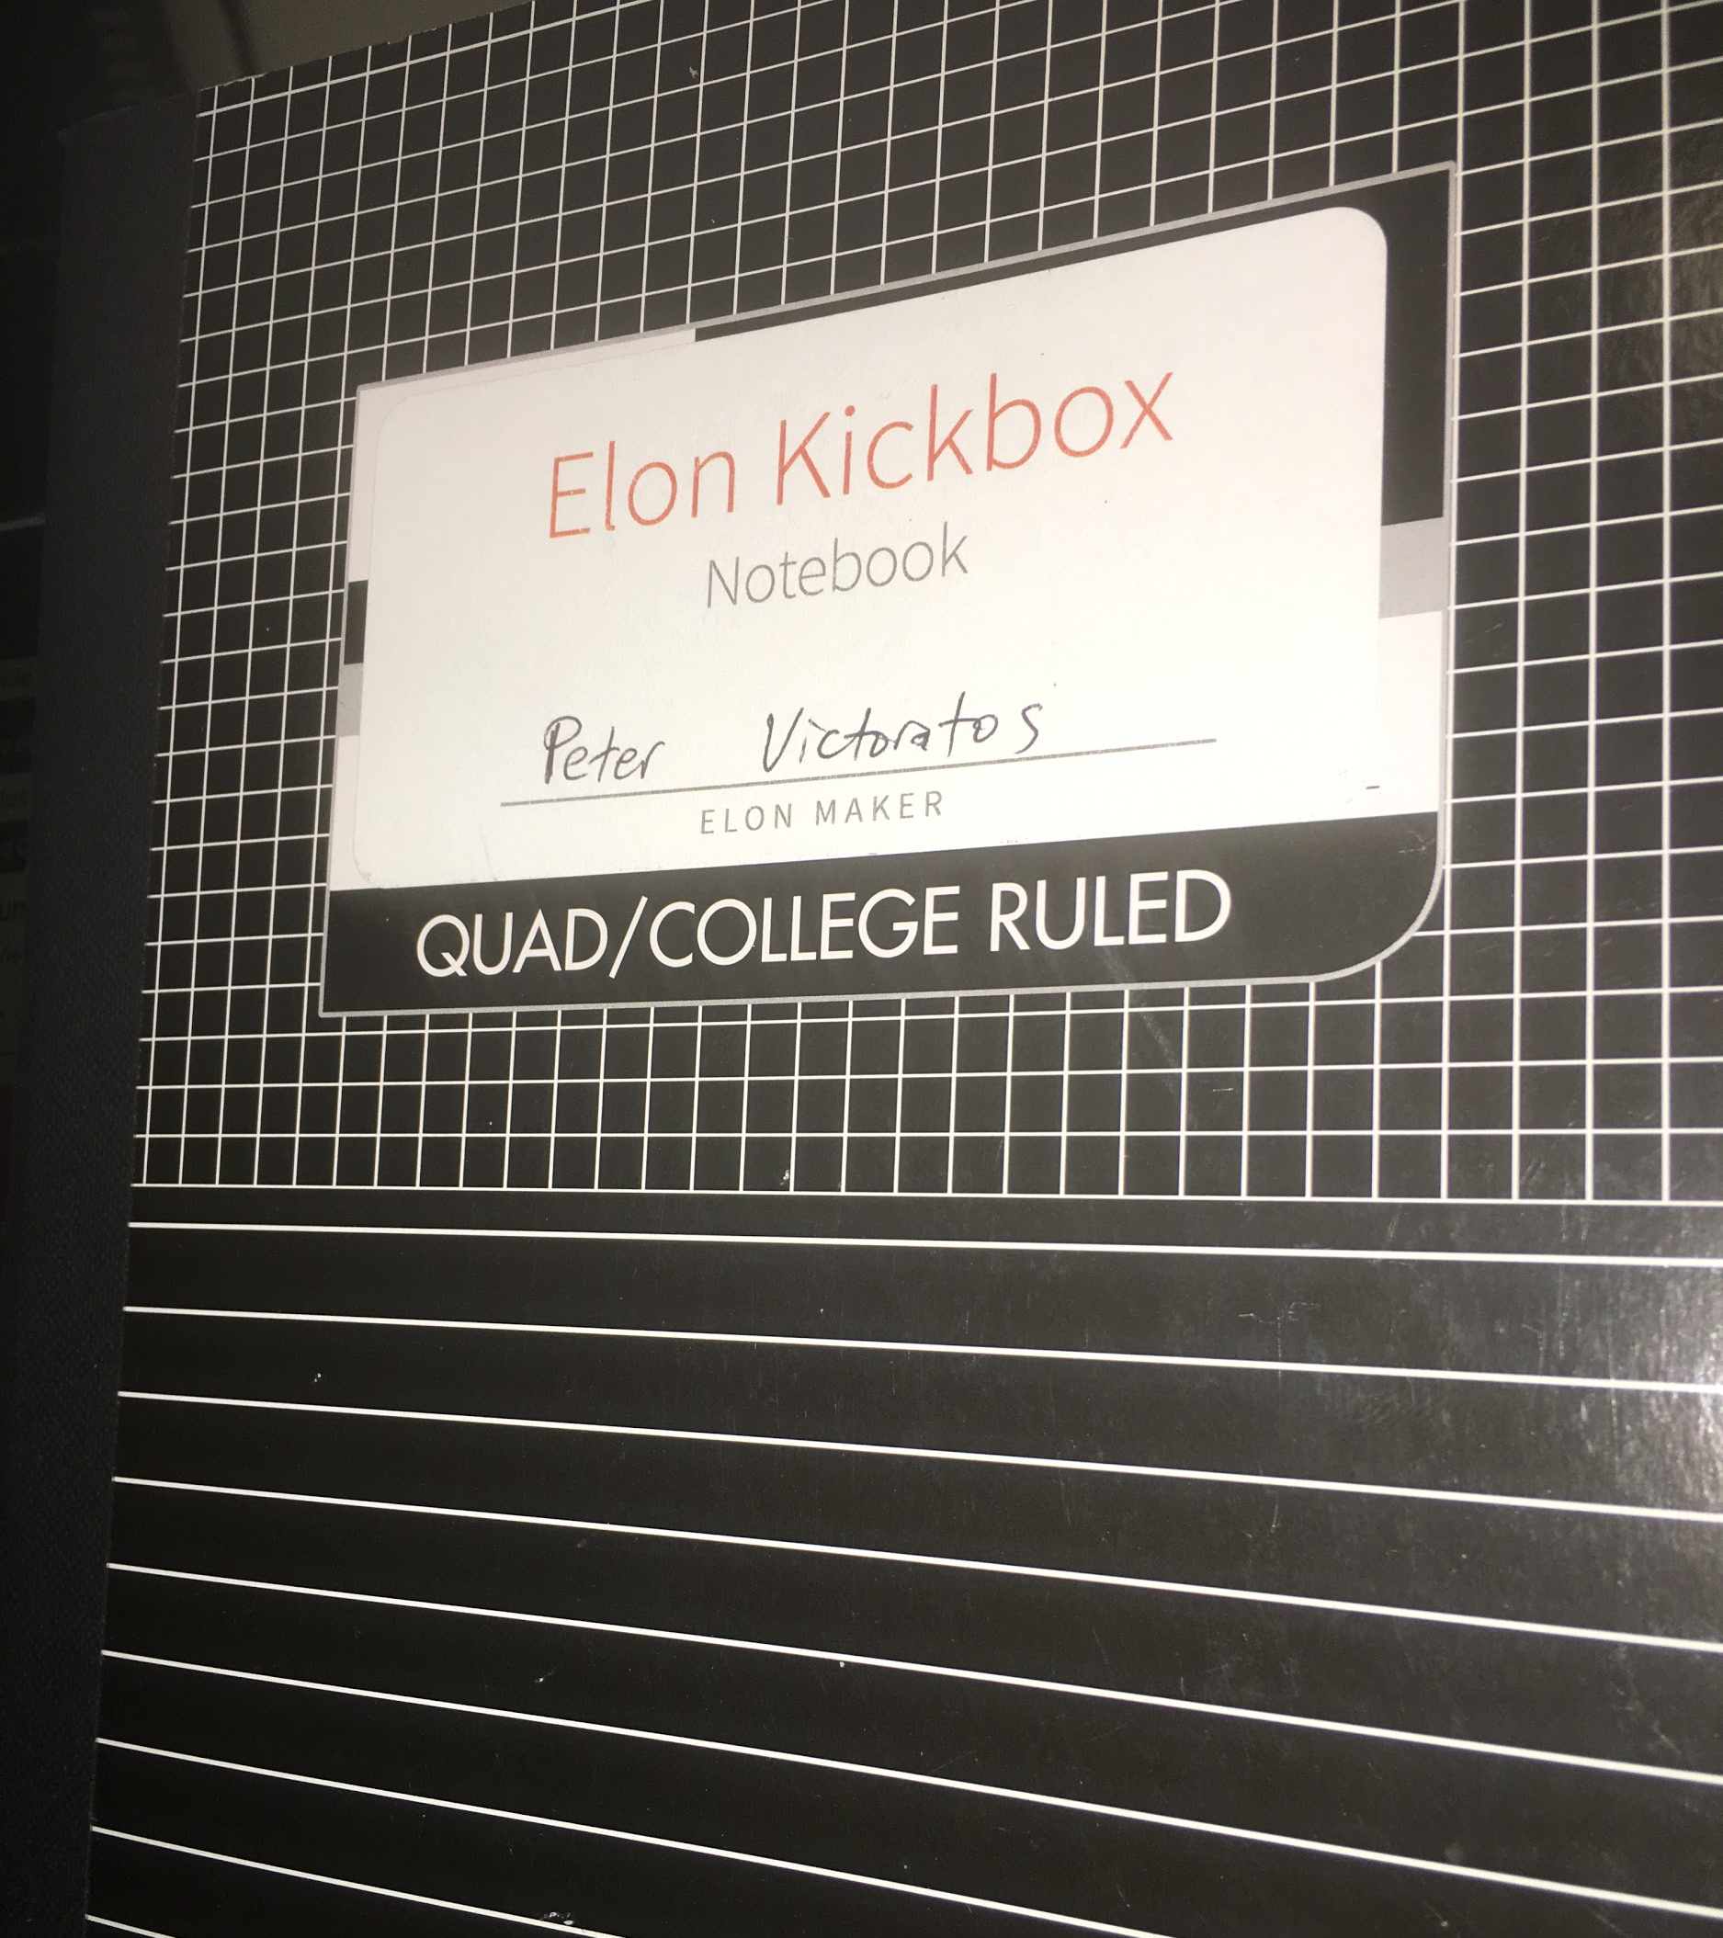
Preliminary Planning

Slide 5
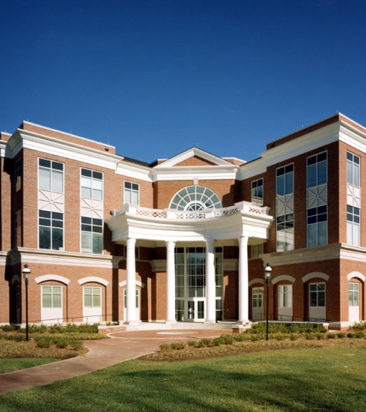
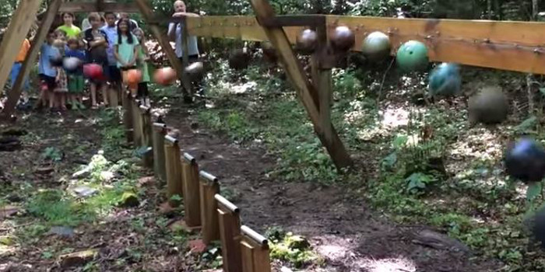
Inspiration
Bowling Ball Pendulum, however this posed some issues to be a KickBox

Slide 6
•Liability
•Budget
•Property Authority

Slide 7
Initial Drawings

Slide 8
Ideas for Infrastructure

Slide 9
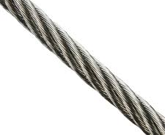
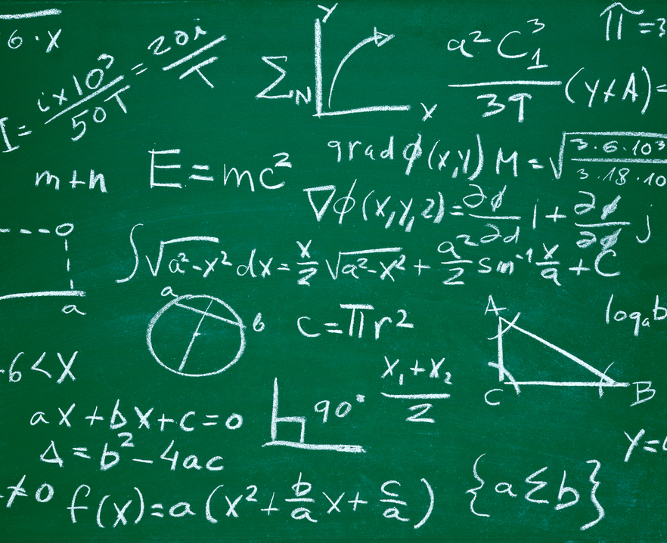
Challenges/Obstacles

Slide 10
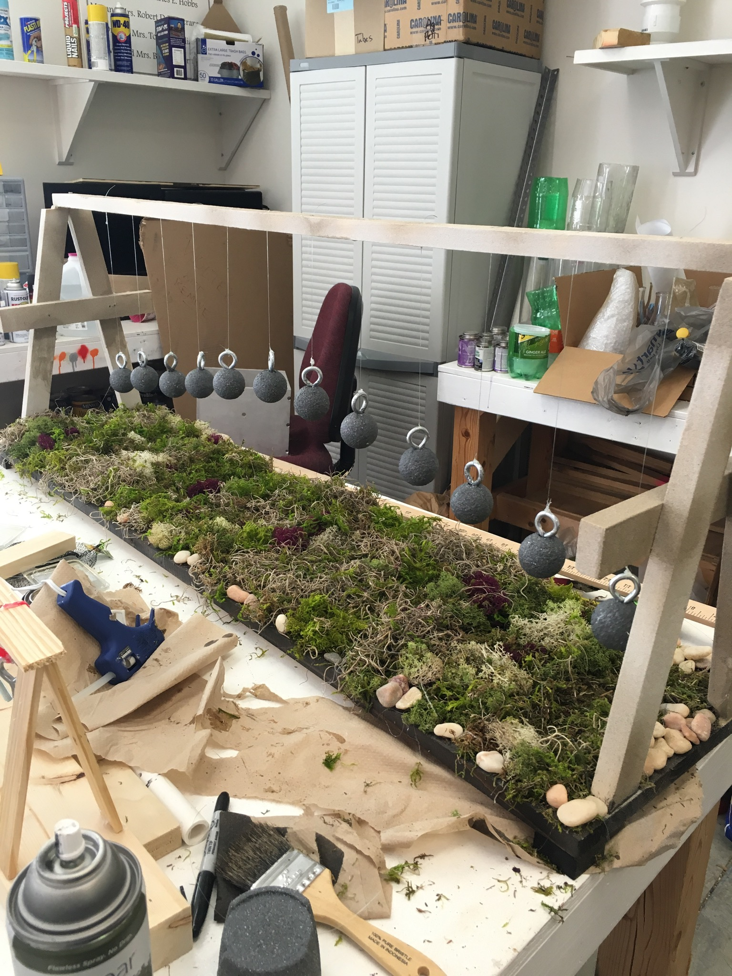

Slide 11
For the Future
???

